Slide 1
Getting Started with Magento 2
September 30th 2016 - Tutorial
Notes:
Greenroom

Slide 2


Mathew Beane
@aepod
Director of Systems Engineering - Robofirm Magento Master 2016 & Certified Developer Family member – 3 Kids and a Wife Zend Z-Team
Notes:
Whoami Magento since 2008
PHP since 2000
Linux since Slackware 2.x days (1994)

Slide 3
Today’s Plan
Magento 2 Application Overview | General Information Hands on Setup
Quick Guide to Magento 2 Development | Application Architecture Backend Development Frontend Development Advanced Concepts
Hands on with Magento 2 | Installing Magento 2 CLI Tools Extension Development Testing (Integration) Design Development
Training and Certification | Magento 2 Training Learning Resources
Magento 2 Toolsets | Backend & Devops Tools Frontend Development Other Tools

Slide 4
Magento 2 Application
Overview

Slide 5


What is Magento?
Open-source PHP E-Commerce Market Leader
Large community
Full Featured E-Commerce Platform
Incredibly Flexible & Highly Structured
Very steep learning curve due to complexity
Enterprise Edition & Cloud Editions Available
So its not a color, super villain or an electrical generator?
Magento is an open-source content management system for e-commerce web sites. - Wikipedia

Slide 6


Magento Version Landscape
Magento 2.1.1 (August 2016) Released and maturing quickly. Full refactor, introducing modern OO concepts.
Magento 1.9.2.4 (Feb 2016)
Currently still supported, until end of 2018, security patches at minimum. Aging, designed pre-2008. Still has the lions share of Magento installations.
Notes:
Over 736 websites on Magento 2.1 out of nearly 4000 active m2 sites
Magento 1 & Magento 2 have over ¼ Million websites running it.

Slide 7
Magento 2 improvements over Magento 1
Modernized web technology stack
Improved performance and scalability
Easy customization
Separate business logic from presentation logic
Cleaner upgrade and installation
High code quality with improved testing framework

Slide 8
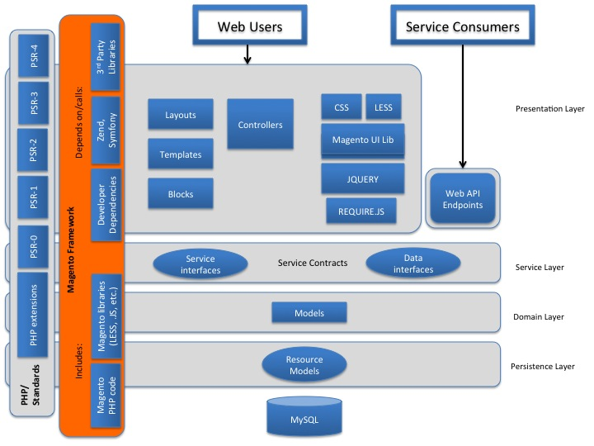




Magento 2 - What's under the hood?
http://devdocs.magento.com/guides/v2.0/architecture/archi_perspectives/arch_diagrams.html
Notes:
HTML5
CSS3 (LESS CSS pre-processor)
JQuery (primary JavaScript library)
RequireJS (library that helps load JavaScript resources on demand)
Third-party libraries (Zend Framework 1, Zend Framework 2, Symfony)

Slide 9
Magento 2 – Quick Feature Overview
Very modular with a strong backbone in open-source
CE will not have all of the scalability and clustering features
Many Client-side and frontend enhancements
Knockout.js as well as a whole uicomponents infrastructure as added
Full refactor of internals with a focus on decoupling and modularity
Up to 3 master databases for separate business domains Main (Catalog),Checkout and Order
Varnish support out of the box (Swapable for FPC)
Support for RabbitMQ and other queueing systems Present in the deferred stock update feature
Asynchronous order insertion
Notes:
Better browser caching
Etag support to control browser cache
Js resource bundles
Minification of css,js,html
Removal of inline js

Slide 10

Magento 2 Application Demonstration
A quick demonstration of the frontend with the Luma theme, and the admin panel.
Notes:
10 minutes – go through frontend, and admin.

Slide 11
Preparation for Workshop – Docker Setup
Use Alan Kents Docker Image: alankent/gsd
https://alankent.me/gsd/introduction-to-docker/
This can be installed on a mac very easily, if you already have docker-toolbox. Just load up Kitematic and search for “alankent/gsd” and click create.
The first install process can take a few minutes, so I suggest starting now if you would like to follow along or look up code etc.

Slide 12
Preparation for Workshop – Get The Code
Grab the code on your local box, to take a look at any code that is referred to throughout this talk.
Go to: https://github.com/magento/magento2
Download as a Zip file, and unzip the code.

Slide 13
Preparation for Workshop – Load Up An IDE
For example in PHPStorm:
create a project from existing source using the code you unzipped.
Use local server / Local source, but skip any http checks, just put in bunk values.
Notes:
The resource roots are marked wrong I think:
App/code/Magento
Lib/internal/Magento

Slide 14
Magento 2 Quick Guide
> Design Patterns
Core code
Module Structure
Templates and Design Structure
Configuration & Data Structure

Slide 15

Magento 2 Design Patterns
Model-view-viewmodel Business logic happens in the models. The view (phtml) is the structure, layout and appearance it communicates with the viewmodel (block).
Front Controller Pattern Magento uses an index.php with a single point of entry \Magento\Framework\App\Bootstrap::create()
Factory Pattern Heavily used by Magento 2, much more granular approach than Magento 1.
Module Pattern Magento relies on a very modular architecture, Magento 2 introduces an Object Manager which really decouples everything nicely compared to Magento 1.
More reading: http://magenticians.com/12-design-patterns-magento
Notes:
This is just a select few of the design patterns used throughout Magento 2 and Magento 1
Magento employs the MySQL relational database management system, the PHP programming language, and elements of the Zend Framework. It applies the conventions of object-oriented programming and model-view-controller architecture. Magento also uses the entity–attribute–value model to store data. - Wikipedia

Slide 16
Additional Magento 2 Design Patterns
S.O.L.I.D. Magento 2 endeavors to use the SOLID principles. Thanks Uncle Bob!
Interceptor A class that works as a plugin to modify the behavior of public functions by intercepting a call and running code before, after or around that function call.
Object Manager
Using several patterns Magento 2 does away with the Mage god object in favor of the Object Manager.
Service Contract Pattern It defines interfaces(data & service) which hide business logic details from service requestors such as controllers, web services or other modules.
Proxy Pattern Resources can consume objects. Defers loading of an objects arguments, built into the Object Manager to deal with performance problems that DI causes.
Notes:
Single Responsibility – classes should only have 1 function
Open Closed – Class open for extension, closed for modification
Liskov Substitution – Quakes like a duck, but needs batteries…. Wrong abstraction (not a duck)
Interface Segregation – client should not be forced to depend on methods it doesn’t use
Dependency Inversion – highlevel modules should not depend on low-level (this is DI)

Slide 17
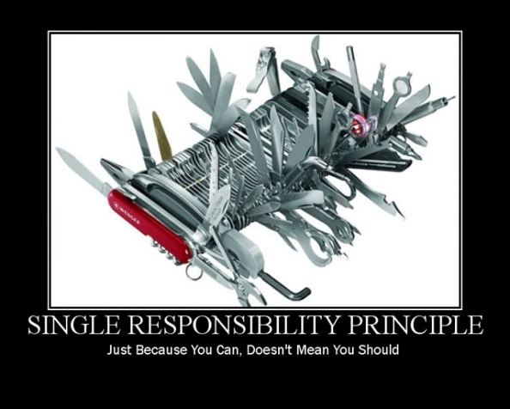




S.O.L.I.D. Expressed in Meme
“Better to practice practical dependency inversion”
Notes:
Single Responsibility – classes should only have 1 function
Open Closed – Class open for extension, closed for modification
Liskov Substitution – In mathematics, a Square is a Rectangle. Indeed it is a specialization of a rectangle. Square setWidth/height fails when inheriting from rectangle.
Interface Segregation – car should be a client of vehicle
Dependency Inversion – highlevel modules should not depend on low-level (this is DI), think power plug or

Slide 18
Magento 2 - Areas
Scope of configuration files Magento 2 only loads what is in scope of the area.
Dependent configuration loading Configuration combined with DI allows for a very flexible configuration scoping that will only load what is needed.
Areas considerations
Both behavior and view components are considered by the scoping by areas.
Six areas correspond to entry points In addition to the typical index.php entry point there are other new entry points:
Admin: index.php or pub/index.php or rest web api
Storefront: index.php or pub/index.php or rest web api
Setup / Install: setup/index.php
Static: pub/static.php
Notes:
We come back to this in a little while during the Configuration part of the quick guide.

Slide 19
Magento 2 - Libraries
Found inside the lib/ folder these will provided building blocks for modules or themes.
PSR-0 compliant, code that is typically not independent business logic features.

Slide 20
Magento 2 – Language Packs
Language packs allow for the display of multiple languages without modifying the application source code.
These are used to replace UI system messages and labels. Basically, a layer that allows for replacing the default en_US with the chosen language.

Slide 21
Magento 2 – Themes and Modules
Themes contain the business logic independent templates and static assets to display the store. Heavily focused on js/css in Magento 2.
Modules are the basic package for code that should contain a particular feature or set of features.

Slide 22
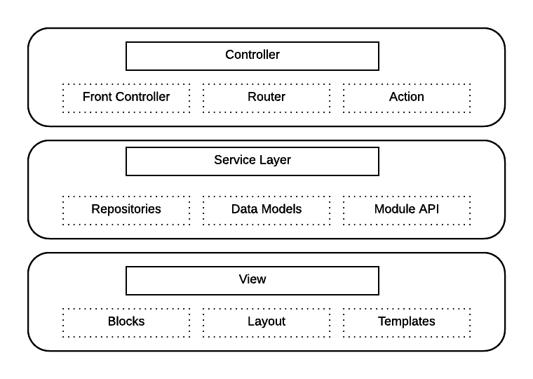
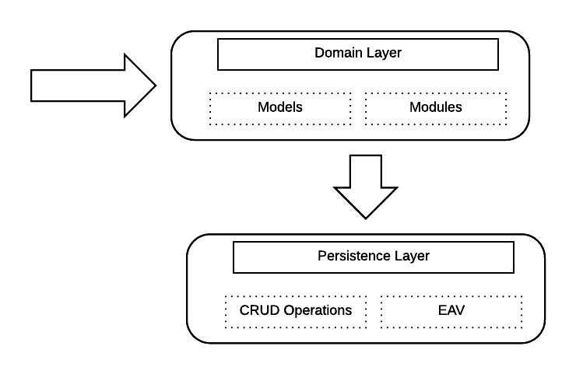
Magento 2 High-Level Application Map
Notes:
Best practice: Use service contracts to communicate to the domain layer by passing data types through strongly typed objects. This practice can help you avoid the need to replace presentation layer code when replacing business layer logic. With API being used as a “core concept” the web api’s have been moved to the “WebAPI”, which has its own service layer.
First we will talk about the request flow and controllers

Slide 23
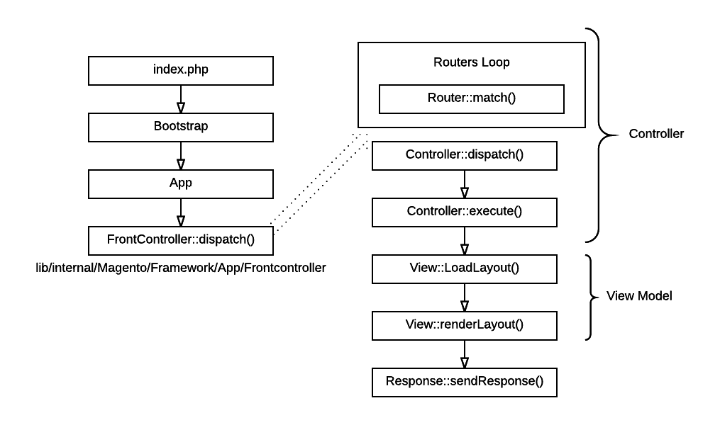
Magento 2 – Request Flow
Notes:
Single controller per action
Web users interact with components of the presentation layer to select actions that initiate calls to the underlying product layers.
Presentation layer components make calls to the Service layer, which in turn sends requests to the Domain (or business logic) layer.
Best practice: Typically, the way it accesses the Model is through service contracts.

Slide 24
Magento 2 – Execution Flow
4 step process
Index.php calls bootstrap
Bootstrap finds and calls controller
Response is loaded and rendered
Response is sent to response object
More reading: http://cedcommerce.com/blog/magento2/request-flow/

Slide 25
Magento 2 High-Level Application Map
Magento 2 is Modular
Notes:
Next we will talk about the service layer

Slide 26
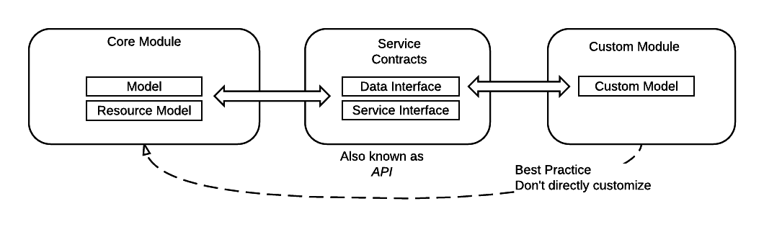
Magento 2 – Service Layer / Service Contracts
Better decoupling minimizes conflicts, confidence is higher with documented interfaces instead of module internals that tend to switch
Harder to perform low level customizations because its harder to implement.
More reading: http://devdocs.magento.com/guides/v2.1/extension-dev-guide/service-contracts/service-contracts.html
Notes:
Debugging is more difficult
Interfaces are more concrete and may be harder to work with.
Service contracts are just interfaces.

Slide 27
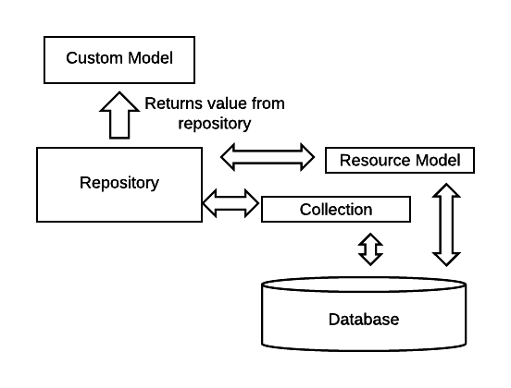
Magento 2 – Data Repositories
Notes:
Repositories uses registries to store previous responses as well, which can lead to really solid data caching.

Slide 28
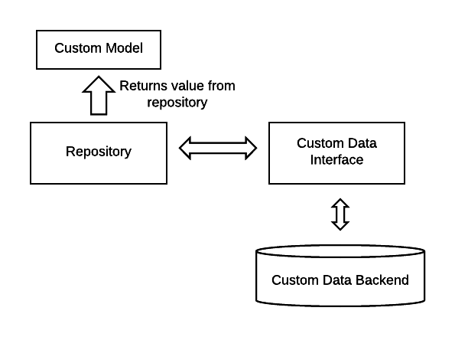
Magento 2 – Data Repositories can be abstracted
This could be an external Database, RabbitMQ or even some 3rd party API
More reading: http://devdocs.magento.com/guides/v2.1/extension-dev-guide/service-contracts/service-contracts.html
Notes:
Repositories provide access to database through a service api
Ensures ability to upgrade, and or migrate datasources etc out from under the api.

Slide 29
Magento 2 – Data Repositories vs. Collections
Repository | Collection
Non-Mutable across releases. Should not change. | Possibility of changes, or replacement.
Deals with Data Objects. | Returns a list of Magento Models.
Provides high-level access to data. | Provides low level access to the database.
Supports filtering and SearchCriteria for filtering, searching and sorting. | Provides own interface for most of the database operations, very customizable.
No low level DB Access. | Nearly unlimited select object customizations available.
More reading: http://devdocs.magento.com/guides/v2.1/extension-dev-guide/service-contracts/service-contracts.html

Slide 30
Magento 2 – Domain & Persistence Layer
Notes:
Domain layer is next. We will be discussing models and modules.

Slide 31
Magento 2 – Modules
These are also called Extensions
Current verbage in devdocs refers to these as Components
These are just logical groups that live in app/code/Namespace/ModuleName
Required Namespace avoids conflicts
Heavy use of Dependency Injection and Object Manager makes them a lot lighter than Magento 1
Design and Template components are now in the same folder.
Everything in Magento 2 is a module
More reading: http://devdocs.magento.com/guides/v2.0/extension-dev-guide/build/build.html

Slide 32
Magento 2 – Dependency Injection
Dependency Injection is the way Magento 2 manages object Dependency.
DI Sets the objects to be used inside of the current object in the constructor
All dependencies are passed into the object instead of being pulled by the object from the environment.
Dependency Injection is managed by the Object Manager
Using DI in Magento 2
Constructor Injection: This is required to establish the dependencies of an object, and in the case of expensive dependencies you must use Proxies.
Method Injection: Used when passing API parameters to API objects that your object will be acting on.

Slide 33
Magento 2 – Object Manager
Responsible for several functions:
Creating objects
Implementing the singleton pattern
Manage dependencies
Automatically instance parameters
Preferences can be set on which interface is used for what object.
Parameters are variables declared in the constructor. (ie. Signature)
Arguments are values passed to the constructor when the class instance is created.
Notes:
OM implements: Get() returns the same object
create() returns a singleton Best practice: request only interfaces, not concrete classes.

Slide 34
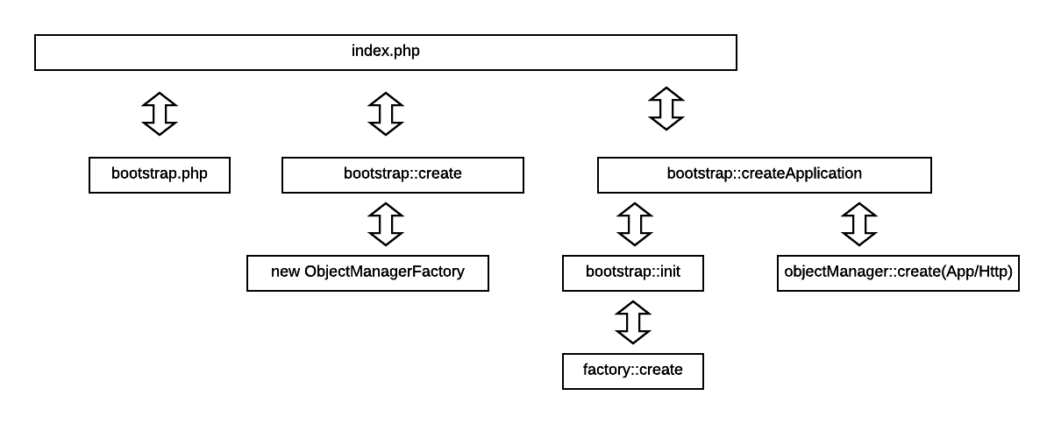
Magento 2 – Object Manager Initiation Process
Notes:
This all fits with the front controller pattern we discussed before. First bootstrap is called, then bootstrap creates the objectmanagerfactory ObjectManagerFactory creates the objectManager
The objectmanager than creates a factory which in turn creates the injected objects. Note that a lot of this is compiled in var/generation and can lead to confusion

Slide 35
Magento 2 – Proxy Objects
Why Use Proxies?
Basically they are used to lazy load slow classes
They extend slow loading classes, wrapping them and ensuring that fast loading classes that are injecting into slow loading class are fast, unless they call the methods in the slow loading class.
If a class has a resource or performance intensive constructor this will lead to other classes that depend on it to be slow.
Hint: Use profiling, which will allow you to generate a dependency graph of objects.
Proxies are Generated Code
They do not need to be written manually, it’s done automatically by code generation.
An example of the di.xml configuration
More reading: http://devdocs.magento.com/guides/v2.1/extension-dev-guide/proxies.html

Slide 36
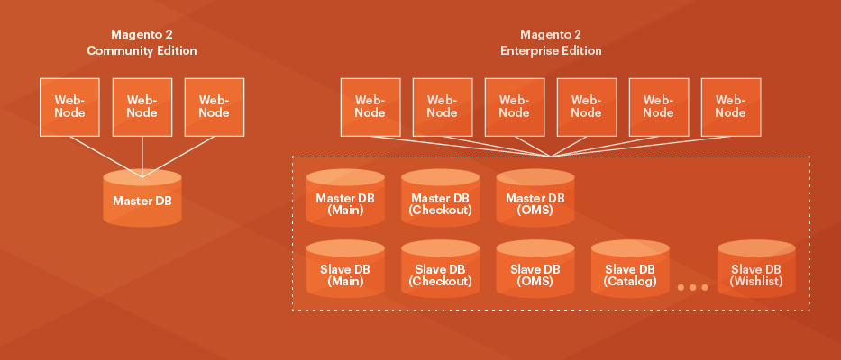
Magento 2 – Persistence Layer / Database Operations
Resource models, used to provide active record and EAV
Executes all CRUD operations
Additional resource dependent business logic, such as data validation
Uses collections to wrap multiple items returned from database queries
Allows for a split into multiple Databases for Multi-Master
More reading: http://devdocs.magento.com/guides/v2.0/config-guide/multi-master/multi-master.html

Slide 37
Magento 2 – View Layer

Slide 38
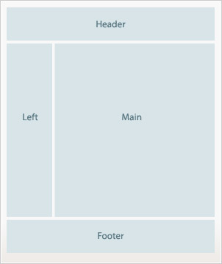
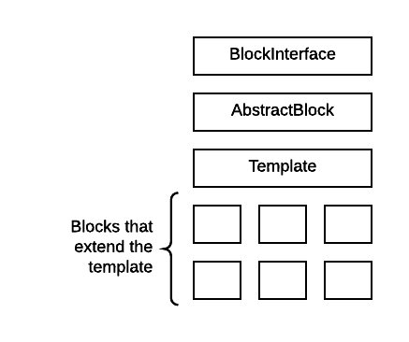
Magento 2 – View / Presentation Layer
Controllers: These can be considered a part of this layer, by there nature they are directly interacting with the web request/response
Layout: Layout is the page structure, represented by a hierarchy of elements. These can be containers or blocks. Technically it is defined in XML files, and is merged from many sources.
Template: Defines the content of the layout blocks. These are used as phtml for backend rendering and html templates for KnockJS scripts.
Blocks: PHP Classes used with the templates.
Base Layout Containers
Notes:
Blocks can generate dynamic content and can contain named child view elements that are similar to arguments being passed in. (Theas attribute holds the child view element names for the parent block to reference them)
Containers collect an ordered group of children view elements.
Presentation code typically calls service contracts, particularly for a store front.
The View layer calls code from the Model to get information about the state of the application

Slide 39
Magento 2 – Presentation Layer (Front End Components)
CSS / LESS: Styling rules for all viewports. CSS is compiled and stored in pub/static.
Magento UI Components Library:
UI Rendering
result page fragments
interactions with javascript
Additionally these provide listing and form components.
jquery & require.js: used extensively throughout the frontend presentation layer.
More reading: http://devdocs.magento.com/guides/v2.0/ui-components/ui-component.html

Slide 40
Magento 2 Quick Guide
Design Patterns
> Core code
Module Structure
Templates and Design Structure
Configuration & Data Structure

Slide 41
Magento 2 Core Code
Partial List of Core Files
index.php, pub/index.php, pub/static.php, bin/magento
app/code/Magento/
app/design/[adminhtml,frontend]/Magento/
lib/
vendor/
For a complete list, download current Magento 2 and look through the code.
Everything installed by Magento could be considered core code.
Notes:
Magento allows class overrides on nearly everything.
Magento’s Event/Observer mechanism is pre-built into most business logic. You can add more if you need.
Designs/Templates have a fallback system that allows you to utilize any of the core layouts and templates, or replace them in your current design.
Even the index.php? Outside of development and very rare implementations you should never need to edit this.

Slide 42


Keep your Magento Core Clean
* Warning * DO NOT EDIT
MAGENTO CORE

Slide 43
Magento Core Changes That Are OK
Patches: Magento 1 required this, Magento 2 does not. (*results may vary)
Updating Shared Libraries: More frequent with Magento 1
Editing core on your local Copy: Careful not to commit any changes from core, employ a .gitignore strategy.
Changing core to learn about Magento is OK
Changing core to debug is OK.
Just do it already, you know you want to edit core.
Notes:
Shared Libraries: For instance CM_Redis, or a payment gateway that are included with core Magento.

Slide 44
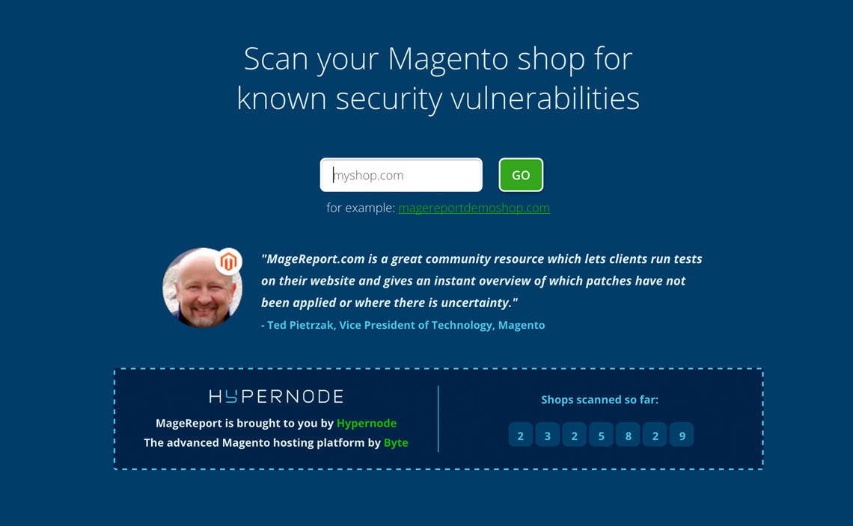
Stay Up To Date
Magento 2 makes updates less painful.
Ensure you have all the patches, as soon as they come out.
Do not be like the people running Magento 1.2, please update.
Use magereport.com to find missing patches or security issues.

Slide 45
Magento 2 Core Directory Overview
/ - Directory Root
Path | Usage
/app/ | This is where all of the code and designs live.
/dev/ | Testing and tools, should not be deployed into production.
/lib/ | Code Library, internal Magento and web libraries, although a lot of 3rd party libraries are in /vendor/ now.
/pub/ | Media, static files, and several other things reside here. This is a new feature with Magento 2.
/var/ | Contains logs, reports, session files and a variety of other goodies.

Slide 46
Magento 2 Core Directory Overview - /app/etc/
/app/etc/
Path | Usage
/app/etc/config.xml | Modules list, this is where you can disable modules.
/app/etc/di.xml | Default settings, typically not touched as these will be defined in specific modules and configuration merged.
app/etc/env.xml | Database settings, crypt key, and all sorts of other goodies. This is the Magento 2 analog of the Mage1 local.xml.

Slide 47
Magento 2 Core Directory Overview - /app/code/
/app/code/
Path | Usage
/app/code/Magento | Core Magento Modules, along with lib/internal/Magento/
/app/code/Example | Modules with the Example vendor name.
/app/code/Example/Foo | The Foo module, inside the vendor name Example.
/app/code/Example/Bar | The Bar module, inside the vendor name Example.

Slide 48
Hold on! Wait a moment…
Really?
Local and community gone? Yes.
app/code/local/Mage? It’s GONE!

Slide 49
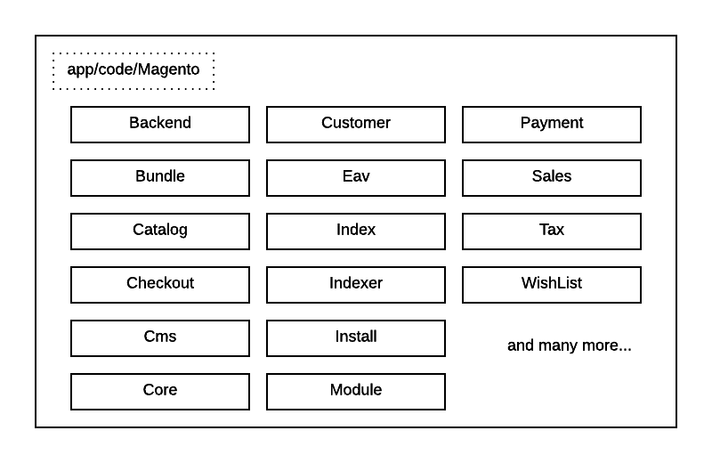
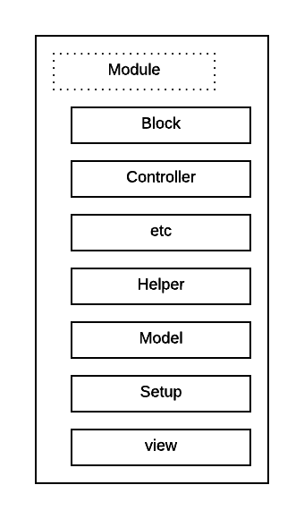
Magento 2 Core Directory - /app/code/Magento
Notes:
Module should actually be called “component” as it is referred to by the documentation.

Slide 50
Magento 2 - /vendor/ Modules
/vendor/<vendor-composer-namespace>/<module_name>
Modules from composers are auto loaded.
These are registered by:
\Magento\Framework\Autoload\

Slide 51
Magento 2 – lib/internal/Magento/Framework
The Magento Framework controls how application components interact, including request flow, routing, indexing, caching, and exception handling.
Framework Responsibilities
Handles HTTP protocols
Interacts with Database and Filesystem
Renders Content
More reading: http://devdocs.magento.com/guides/v2.0/architecture/archi_perspectives/framework.html

Slide 52
Magento 2 – lib/Magento/Framework
Namespace | Purpose
Magento\Framework\Object | Provides standard functionality for storing and retrieving data through magic methods, and the base class for most Magento classes.
Magento\Framework\Object\Model | Base model that nearly all Magento Model classes extend from.
Magento\Framework\Object\View | Renders pages and layouts
Magento\Framework\ObjectManager | Provides dependency injection.
Magento\Framework\App | Framework code that handles the Magento application bootstrap, base config load, routing, and context.
Magento\Framework\Config | Generic configuration reader and specialized readers for each config type.
Magento\Framework\Event | Handles events and observers.

Slide 53
Magento 2 Core Directory Overview
/app/design/
Path | Usage
/app/design/adminhtml/Magento/backend | Default adminhtml design/skin. All components separated by module.
/app/design/frontend/Magento/blank | Default empty theme. Typically a few default pieces of css.
/app/design/frontend/Magento/luma | The default theme for Magento 2. Contains layouts, templates, css and other components.

Slide 54
WAIT…. What?
/skin/ directory removed? Yes.
What about template overrides? ...

Slide 55
Magento 2 Quick Guide
Design Patterns
Core code
> Module Structure
Templates and Design Structure
Configuration & Data Structure

Slide 56
Exploring Magento Modules - Overview
Module Code
Configuration: Module status and xpath configuration values
Blocks: php business logic interface for phtml templates
Controllers: request routing
Helpers: general functions and helpers
Models: Business Logic, Resource Models for DB, and Collections
Installers/Upgrade: Simplified compared to Magento 1
Ui components : PHP classes tie frontend components to data providers
Design Components (now part of the module in the view/ directory)
Layouts: XML Configurations
Templates: phtml templates
Static Files (css,js,media)
Notes:
These are actually called components now, very confusing change.
We will be covering a few of these in a slightly different order.

Slide 57
Magento 2 - Minimal Module
Create a namespace app/code/Workshop
Create a module directory app/code/Workshop/Helloworld
Create a config app/code/Workshop/Helloworld/etc/module.xml
Create a registration.php app/code/Workshop/Helloworld/registration.php
Run setup:upgrade in shell bin/magento setup:upgrade
Notes:
At this point you have a “working” module.
You will be able to see it in the setup_module table in the database and in the app/etc/config.xml/ Registrar::register just adds the path of the module to ComponentRegistrar which is used later by the object manager
There can also be a composer.json here, and will be if you need dependencies on other extensions etc.

Slide 58
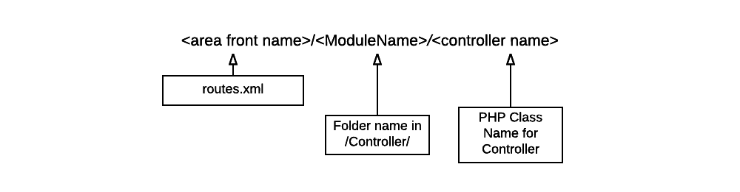
Magento 2 Module – Routes Overview
Area Front Name: Declared in routes.xml for the module
Module Name: This is a folder inside the controllers folder in the module
Controller Name: This is a php class in the folder, that has the execute() method and it extends from \Magento\Framwork\App\Action\Action
http://mage2.local/workshop/hello/world
Notes:
One class per action.

Slide 59
Magento 2 Module – Controllers
http://mage2.local/workshop/hello/world

Slide 60
Magento 2 Module – Controllers
Notes:
Controller calls page factory, creates page, and returns object. Note, this will not work at this stage, we still have to add a block and view.

Slide 61
Magento 2 – High Level Routing Flow
Notes:
All controllers must inherit \Magento\Framework\App\Action\Action which will have the dispatch() (used to wrap logic) It’s important that every controller extends this class to inherit needed methods and to allow front controller to call dispatch method (which will call execute method).
Action also has Forward and Redirect methods (forward is internal)
Dispatch calls the controller::execute passing back the result/response

Slide 62
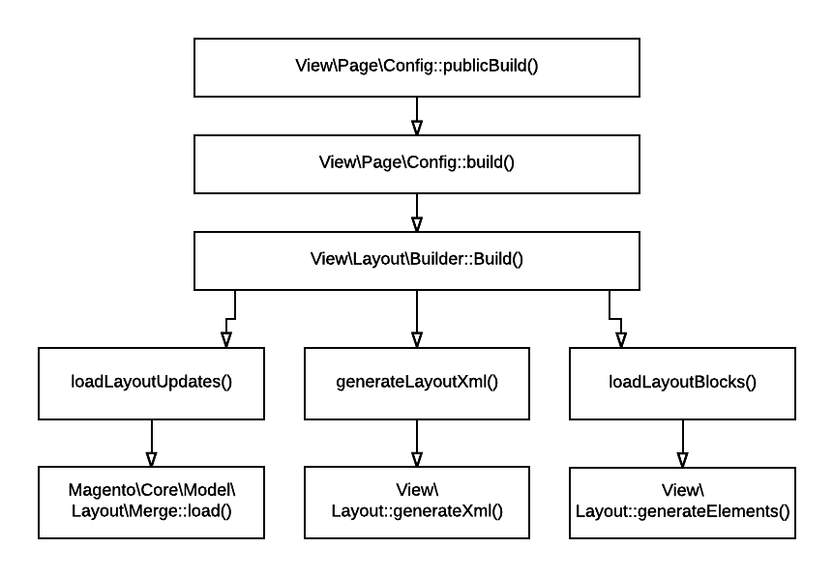
Magento 2 – Render Build Process
Notes:
Before talking about the view, lets look at how the rendering flow looks.
By this time most if not all of the work to load the required models, components, etc all done.
Layouts are loaded, merged, blocks are generated along with children and elements of those blocks.

Slide 63
Magento 2 Module – View Render Flow
Gather Layouts
Generate page layout XML
Generate Blocks
Execute output blocks
Include Templates
Execute Child Blocks
Finally flush output
Loops back to load templates
Notes:
La

Slide 64
Magento 2 – Layouts, Blocks and Templates
The Layout XML: Declares the block and template files.
app/code/vendor/module/view/[frontend/admin]/layout/route.xml
The Block Class: Extends template and implements the _prepareLayout(). app/code/vendor/module/Block/BlockClass.php
The Template: app/code/vendor/module/view/[frontend/admin]/templates/template.xml
Notes:
There are three basic parts of a layout/view.

Slide 65
Magento 2 – Layout Helloworld Example
Layout XML
The Block Class
The Template

Slide 66
Magento 2 Module – Models
Magento 2 models differ from a typical MVC implementation in the following ways
Database access is abstracted through resource models and collections
Models only contain business logic and are database-agnostic. Model objects contain the business logic for a component, not just a type of object.
Each Model that requires database access will have an individual resource model for each model object.
Dependency Injection plays a pivotal role in Models. All mapping of models is done using di and all models are loaded from the object manager.
Properly written Magento 2 modules will not extend core models. Instead use Service Contracts and resource models, which would pull from the Repository. (Service and Data Interfaces)
Source: http://devdocs.magento.com/guides/v2.0/architecture/archi_perspectives/components/modules/mod_anatomy.html
Notes:
Service contract interfaces are outside the scope of todays tutorial even though this is the right way to do it.

Slide 67
Magento 2 Module – Installers / Upgrades
Uses the module version in app/etc/config.xml and compares against setup_module in the database.
These are found in the Setup directory in a module
2 Phases to install or upgrade, both use the following:
Schema install and upgrades
Data install and upgrades
Only fires when you do a bin/magento setup:upgrade
Uninstall Event exists, but use with caution
More reading: http://devdocs.magento.com/guides/v2.0/extension-dev-guide/prepare/lifecycle.html
Notes:
Schema installation only on install, the first thing your modules does is perform a schema installation by executing its installation class.
Schema upgrade If your module already has an earlier version installed in Magento, then it will perform a schema upgrade instead of an installation. The purpose of a schema upgrade is usually to update the database structure or apply patches. Data installation only during the initial installation of your module. The purpose of data installation is usually to populate the database with initial data for your module.
Data upgrade The purpose of this stage is usually to fix data that has been corrupted or populate a new data field from a schema change.

Slide 68
Magento 2 Module – UI Components
Provides LESS-based frontend library
Employs a wide variety of mixins for base elements
actions-toolbar breadcrumbs buttons drop-downs forms icons layout loaders messages pagination | popups ratings sections tabs and accordions tables tooltips typography list of theme variables
More reading: http://devdocs.magento.com/guides/v2.0/frontend-dev-guide/css-topics/theme-ui-lib.html

Slide 69
Magento 2 Module – UI Components

Slide 70
Magento 2 Quick Guide
Design Patterns
Core code
Module Structure
> Templates and Design Structure
Configuration & Data Structure

Slide 71
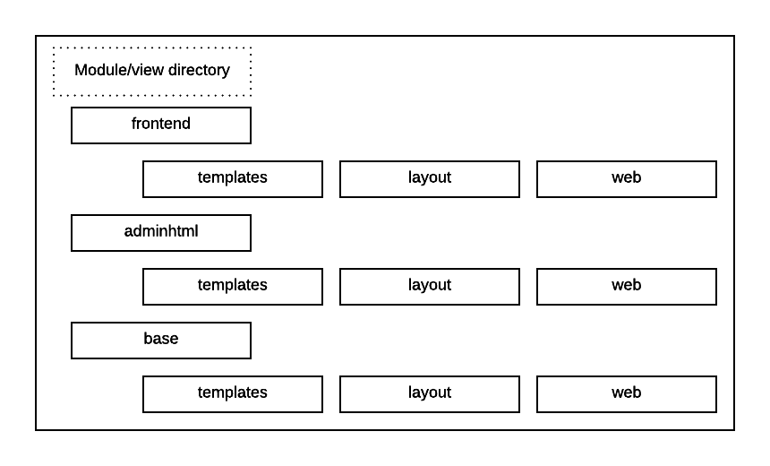
Magento 2 Core Overview - Templates
Templates: phtml files, the real templates.
Layout: xml files, this is all of the layout declarations.
Web: Asset files, css, images and javascript

Slide 72
Magento 2 Layouts
XML files that allow for most customizations you would do to the page layout.
These can be used to move elements, add and remove content or elements and so on.
Common layout instructions used to customize layouts:
Notes:
Altering templates is another way to change the page layout block: A block is a unit of page output that renders some distinctive content – a piece of information, a user interface element – anything visually tangible for the end-user.
Container: A container renders child elements during view output generation.
b/a attrib: To help you to position elements in a specific order suitable for design, SEO, usability, or other requirements, Magento software provides the before and after layout attributes.
Action: Used to set up the execution of a certain method of the block during block generation; the <action> node must be located in the scope of the <block> node.
referenceBlock: used to target blocks/containers
Argument: passes in arguements

Slide 73
Magento 2 – Layouts, Blocks and Templates
Layouts typically instance associated block+template
From: <Magento_Catalog_module_dir>/view/frontend/layout/catalog_category_view.xml
<block class="Magento\Catalog\Block\Category\View" name="category.image" template="Magento_Catalog::category/image.phtml"/>
This means that the category.image block is rendered by the image.phtml template, which is located in the category subdirectory of the Magento_Catalog module template directory.
Source: http://devdocs.magento.com/guides/v2.1/frontend-dev-guide/templates/template-override.html#template-layout

Slide 74
Magento 2 Themes
Packages are gone, replaced with Theme Dependency.
Theme dependency is configured in the xml for the theme, each theme can depend on one other theme, allowing for chained themes.
Theme Scope is more concrete and easier to understand and see on themes now, with each store and website represented in a table.
Found in the admin under content->configuration.

Slide 75
Magento 2 Core Overview - Design
Templates: phtml files, the real templates.
Layout: xml files, this is all of the layout declarations.
Web: Asset files, css, images and javascript

Slide 76
Magento 2 Themes/Design Fallback
Magento 2 uses Theme inheritance to find static assets, which in the end get deployed into the pub/static folder.
pub/static/frontend/Magento/luma/en_US/
All web requests for assets will end up pulling any static file from the proper location in pub/static.
These assets are generated by the CLI command: setup:static-content:deploy or by the pub/static.php file if you are in development mode.

Slide 77
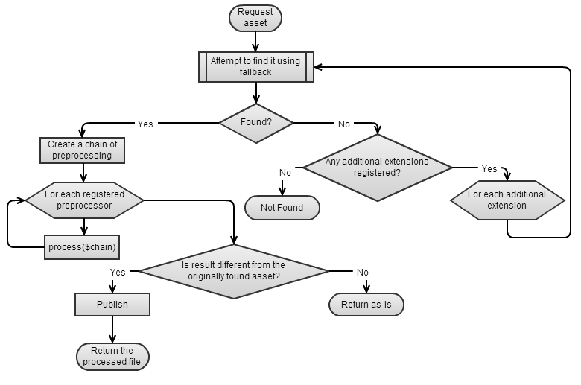
Magento Themes/Design Fallback
The view file fallback mechanism which includes a preprocessor for css/js
CSS is processed with LESS
JavaScript is merged and minified
These preprocessors can be extended easily.
More reading: http://devdocs.magento.com/guides/v2.0/architecture/view/static-process.html

Slide 78
Magento 2 Themes Inheritance
“Theme inheritance is based on the fallback mechanism, which guarantees that if a view file is not found in the current theme, the system searches in the ancestor themes, module view files or library.”
Themes have parents, this is their fallback.
Modules follow a fallback, this is affected by module context.
Templates fallback to the current theme, ancestor theme and then the module.
Layouts can be extended or you can do an override.
More reading: http://devdocs.magento.com/guides/v2.1/frontend-dev-guide/themes/theme-inherit.html
Notes:
Overriding Layouts is not recommended.

Slide 79
Magento 2 Quick Guide
Design Patterns
Core code
Module Structure
Templates and Design Structure
> Configuration & Data Structure

Slide 80
Magento Configuration Structure
XML Based, with REQUIRED XSD files
XSD has schemas for individual and merged validation
Additionally there is a group of classes that are used to load the XML config:
Magento\Framework\Config
Config: Provides access to config values.
Reader: Used to read files, usually only encapsulates a single file name.
SchemaLocator: Gives the path to the schema.
Converter: Class that converts XML to array
This is all fully extensible, you can create your own Config types as well.

Slide 81
Magento 2 Configuration Files Load Order
Files are loaded in the following stages:
Primary: Bootstrap loads only config files needed for the app to start up, and possibly installation specific configs.
Global: Includes config files that are common across all app areas
Area: Files that are applied to specific areas such as frontend or adminhtml are loaded.

Slide 82
Magento 2 Config Types
core_config_data: Config values that have been stored in the database.
XML Configurations:
di.xml: Used for dependency injection
config.xml: top level configuration values
acl.xml: Access control list configuration values
module.xml: specifies module version number, and dependency load order
And many more….
More reading: http://devdocs.magento.com/guides/v2.1/config-guide/config/config-files.html

Slide 83
Magento 2 Configuration Scope
Default Scope
Default Values
Used if not found in scope
Website Scope
Website scope is used to override global scope per website.
Used to support Multi-Store environments
Store Group Scope
Root Category configuration and part of the unit tests.
View Scope (subset of website scope)
Used for currency, tax, and language settings
Typically shown as a dropdown for Language/Currency
Limited Configuration Values Available
Source: https://cyrillschumacher.com/2015/04/20/magento2-stores-and-scopes/

Slide 84
Magento 2 Database Interface Structure
Magento uses a basic CRUD Model
There are three basic components to the data interface
Model: Doesn’t contain database code
Resource Model: Read/Write adapters for communicating to database
Collection: PHP Object used to hold model instances, implements several PHP Standard Library interfaces to work with the collection.
Factory Methods: Many auto-generated methods exist for common interactions
“Most Magento Models can be categorized in one of two ways. There's a basic, ActiveRecord-like/one-object-one-table Model, and there's also an Entity Attribute Value (EAV) Model.“
- http://devdocs.magento.com/guides/m1x/magefordev/mage-for-dev-5.html
Notes:
Collections implement: IteratorAggregate and Countable
Model Collections as arrays that also have methods attached.

Slide 85
Break Time
Free Coffee

Slide 86
Hands on with Magento 2
A guide to installation

Slide 87
Magento System Requirements
Operating System
Linux x86-64
Web Server
Apache 2.2
Nginx 1.7.x
Database
MySQL 5.6 (Oracle or Percona)
PHP
PHP 5.6, PHP 7.x
Required PHP Extensions
CURL
DOM
gd
hash
Iconv
mbstring
mcrypt
pcre
pdo
pdo_mysql
Simplexml
xsl
Optional Services
Redis
Memcache
Varnish 3.5 or 4.x
Other Components
composer
PHPUnit

Slide 88
Magento 2 – Install Procedure – Magento Connect Auth Key
Before you start
Ensure you have an authentication token: http://devdocs.magento.com/guides/v2.0/install-gde/prereq/connect-auth.html
Go to Magento Marketplace.
Click Sign In and enter your login credentials.
If you don’t have a free account, click Create an Account.
After you log in, click My Access Keys
If you already have keys, use the Public key as your user name and the Private key as your password.
To create a new key pair, click Create a New Access Key.
When prompted, enter a descritive name to identify the key pair.
Click Generate New.
Use the Public key as your user name and the Private key as your password.

Slide 89
Manual Installation
http://devdocs.magento.com/guides/m1x/install/installing_install.html
Installing Magento from scratch is really only a couple basic steps.
Create database, database user and proper grants.
Copy source files into the webroot.
(Optional) Add sample data to database, and media to webroot/media
Set and confirm permissions on all files for webserver.
Point web browser at your webroot.
Step through the installer.
Do any post install tasks, because your done.

Slide 90
Magento 2 – Installing, getting the code
Create the Database To install Magento you will need a database in place, in the example below we are using the magento2 database, which has already been created.
Run Composer composer create-project --repository-url=https://repo.magento.com/ magento/project-community-edition .
Run Magento Install php bin/magento setup:install --db-name=magento2 --db-user=dev --db-password=password1 --admin-firstname=mathew --admin-lastname=beane --admin-password=great-pass1 --admin-user=dev --admin-email=mbeane@robofirm.com
Notes:
Permissions can be an issue. See devdocs for more info

Slide 91
Magento 2 – Command Line Installer
Create the Database To install Magento you will need a database in place, in the example below we are using the magento2 database, which has already been created.
Run Composer composer create-project --repository-url=https://repo.magento.com/ magento/project-community-edition .
Run Magento Install php bin/magento setup:install --db-name=magento2 --db-user=dev --db-password=password1 --admin-firstname=mathew --admin-lastname=beane --admin-password=great-pass1 --admin-user=dev --admin-email=mbeane@robofirm.com
Notes:
Permissions can be an issue. See devdocs for more info

Slide 92
Magento 2 – Installing, getting the code
For the installer set up, this can be done at the web interface as well by navigating to the following URL: http://local-magento2.robofirm.net/setup/
If using nginx you will need special rules in place for this and pub/static and other places.
This should guide you through the whole process in a web gui
I don’t use this method, so you will have to experiment on you own.
GUI Install
Readiness Check
Database Setup
Web Configuration
Store Customization
Admin Account
Install Process
Notes:
Customize allows you to set default timezone, currency, languages and modules

Slide 93
Magento 2 – Sample Data Install
git clone git@github.com:magento/magento2-sample-data.git ~/sampledata
cd ~/sampledata/dev/tools
php -f build-sample-data.php -- --ce-source=/var/www/magento2_0
Go back to your web directory: cd /var/www/magento2_0/
Run the deploy: bin/magento sampledata:deploy
Run bin/magento setup:upgrade

Slide 94
Magento 2 – Upgrading Core
Change the composer.json
Run composer upgrade
Run bin/magento setup:upgrade

Slide 95
Hands on with Magento 2
CLI Tools

Slide 96
Magento 2 CLI – Commands Overview
bin/magento module:enable This handles enabling modules, there is also a disable command. You can also set the etc/config.xml line to 0 as well.
bin/magento setup:static-content:deploy Used in production mode, to deploy static content. This should not be run if you are in developer mode.
bin/magento setup:di:compile Generates missing interceptors in var/generation
bin/magento deploy:mode:set [development/production] When working with development ensure that you are in development mode. This way you will do a LOT less cache clearing and static content generation
bin/magento cache:flush One of the most common commands I run while developing with Magento2

Slide 97
Magento 2 CLI – Commands Overview
Other Commands:
You can create admin users
You can do a lot of store maintenance tasks
You can run all the tests (would not suggest this)
Enable/Disable Maintenance mode
Install Magento and Extensions
You can extend the CLI to do whatever you want including development tasks

Slide 98
Hands on with Magento 2
Extension Development

Slide 99
Magento 2 Extensions – Create Workshop Extension
Create Helloworld from Earlier, run it.

Slide 100
Hands on with Magento 2
Integration Testing

Slide 101
Magento 2 Integration Testing – Test Workshop Extension
http://davidalger.com/development/magento/running-the-magento-2-test-suite/
Step 1: Place the following (updating it with proper credentials for your MySql server) in dev/tests/integration/etc/install-config-mysql.php <?php return [ 'db-host' => 'dev-db', 'db-user' => 'root', 'db-password' => '', 'db-name' => 'magento_integration_tests', 'db-prefix' => '', 'backend-frontname' => 'backend', 'admin-user' => \Magento\TestFramework\Bootstrap::ADMIN_NAME, 'admin-password' => \Magento\TestFramework\Bootstrap::ADMIN_PASSWORD, 'admin-email' => \Magento\TestFramework\Bootstrap::ADMIN_EMAIL, 'admin-firstname' => \Magento\TestFramework\Bootstrap::ADMIN_FIRSTNAME, 'admin-lastname' => \Magento\TestFramework\Bootstrap::ADMIN_LASTNAME, ];

Slide 102
Magento 2 Integration Testing – Test Workshop Extension
http://davidalger.com/development/magento/running-the-magento-2-test-suite/
Step 2: Create the database referenced in the above config:
1 | mysql -e 'create database magento_integration_tests'

Slide 103
Magento 2 Integration Testing – Test Workshop Extension
http://davidalger.com/development/magento/running-the-magento-2-test-suite/
Step 3: Use the following to run the integration tests:
You can, as with the unit tests, choose to run a sub-set of the integration tests.
1 2 | cd dev/tests/integration/ ../../../vendor/phpunit/phpunit/phpunit
1 2 3 | cd dev/tests/integration/ ../../../vendor/phpunit/phpunit/phpunit \ testsuite/Magento/Catalog/Model/Product/ImageTest.php
Notes:
../../../vendor/phpunit/phpunit/phpunit \ testsuite/p

Slide 104
Magento 2 Integration Testing – Test Workshop Extension
http://davidalger.com/development/magento/running-the-magento-2-test-suite/
If there is time follow: http://vinaikopp.com/2016/02/05/01_the_skeleton_module_kata/
Notes:
../../../vendor/phpunit/phpunit/phpunit \ testsuite/p

Slide 105
Hands on with Magento 2
Design Development

Slide 106
Magento 2 Designs – Create Workshop Theme
http://devdocs.magento.com/guides/v2.1/frontend-dev-guide/themes/theme-create.html
Create Theme Dir: /app/design/frontend/<Vendor>/<Theme>
Create a theme.xml in you theme dir
Create composer.json
Create registation.php
Enable theme in admin
Create and modify a view.xml changing image category_page_grid
If there is time play with: http://devdocs.magento.com/guides/v2.0/frontend-dev-guide/layouts/xml-manage.html
Make a page 1-column

Slide 107
Magento 2 Training
Learning Magento 2

Slide 108
Magento Training
Dev Docs: http://devdocs.magento.com/ Great documentation, always being improved.
Alan Storm: http://alanstorm.com/category/magento-2 Alan has been hard at work writing quality blog posts about Magento 2, do not over look the Pulse Storm – Commerce Bug Tool by him.
Magento: https://magento.com/training/catalog/developers This is a good set of classes, including some for front-end development and other components. Expect more soon!

Slide 109





Magento Certification
Magento has 4 Certifications:
Certified Solution Specialist
Front end developer
Certified Developer
Certified developer plus
“Experienced Magento professionals can validate their real-world skills by earning a Magento Certification. Magento Certification Exams are geared toward professionals who want to differentiate themselves from the competition with the ultimate Magento credential.” - http://magento.com/training/catalog/certification
Notes:
Css: ecommerce business goals according to best practices
Fed: theming components and the ability to modify the user interface according to best practices
No Magento 2 Certification yet except Trained Partner Program.

Slide 110
Magento Certification Subjects
Basics: Introduction to Magento code hierarchies, modules and configuration.
Request Flow: Learn how Magento bootstraps itself and handles requests.
Rendering: Understand how pages are rendered - themes, layouts, blocks and templates
Databases: Discover models, resources models and collections.
EAV: Entity Attribute Value tables, explained.
Adminhtml: Manage admin area forms and grids.
Catalog: Find out about categories, products, layered navigation and taxes.
Checkout: Covering quotes, orders and shipping and payment methods
Sales: Order creation and management
Advanced: API and Widgets etc

Slide 111
Certification Study Guides
http://info.magento.com/rs/magentocommerce/images/Certification-Study-Guide-MCD-v1.pdf Official study guide, a good starting point for studying for the exam. It will give you a broad overview of the subjects.
http://magento.com/training/catalog/technical-track On-demand course, really quite a good course even if a bit dated. Then again, so is the test.
http://magento.com/training/catalog/moderators-kit Cheap alternative, covers the entire gamut of the test and is really a great learning tool for teams.
http://magecert.com/ Put together by some of the community as a way to dig into examples for each of the subjects in the test.
https://shop.vinaikopp.com/grokking-magento/ A great companion to the moderators kit, with Vinai Kopp taking you through each of the examples for the first part of the moderator kit.

Slide 112
Magento Community – Get Involved.
Get involved:
Twitter: #realmagento hashtag
Stackexchange: http://magento.stackexchange.com/
Imagine 2017: http://imagine.magento.com/
Local PHP and Magento User Groups

Slide 113
Magento 2 Toolsets

Slide 114
IDE Choices
PHPStorm with Magicento Plugin PHPStorm with the Magicento is also very popular. https://www.jetbrains.com/phpstorm/ http://magicento.com/
Zend Studio Built in support for Magento, built on eclipse and a very nice platform for editing Magento. http://www.zend.com/en/products/studio
VIM Don’t ask me how to use it, I still use vi when at the shell. However, I know a lot of developers who swear by this.

Slide 115
Server Stack
Typical LAMP Stack: Nginx also works well, but will require some extra configuration.
Docker: there are several great choices with docker and Magento 2. This has been where most of my development with Mage2 has been done.
Zend Server: Zend provides great PHP support. It has Z-Ray, tools for deployment, monitoring and other features which make it very nice in production.
Z-Ray: With built in support for Magento 2, this is a great way to get insight into the application. Now available sans-zendserver, although not in a php7 flavor yet.
Newrelic: Magento even has an official plugin to send data to newrelic. http://newrelic.com/robofirm
blackfire.io: Used for tracing code, like newrelic + xhprof.

Slide 116
Application Stack
N98-magerun2: https://github.com/netz98/n98-magerun2 A must have CLI tool, the swiss army knife for Magento Developers.
Frontools: https://github.com/SnowdogApps/magento2-frontools Frontend tools based in Gulp.js
Alan Storm’s Commerce Bug: http://store.pulsestorm.net/products/commerce-bug-3 This thing is amazing, best $100 I ever spent on Magento.
Notes:
N98: customer, admin, db, index, cache, config values, system, cron, module versions, and on and on and on
Frontools: Does some pretty amazing frontend development tasks, and can be used in the deployment pipeline.
Commercebug: controller, module, crud, collection, blocks,layouts,events,observers, some system tasks

Slide 117
Magento 2 – Vagrant Boxes for Development
Magescotch: https://github.com/joshuaswarren/magescotch Magento 1 and 2 on PHP 7. Vmware or Virtualbox. Magescotch5 has php5 + Z-Ray.
EcomDev/fast-hypernode https://github.com/ecomdev/fast-hypernode/ A fork of the Byte Hypernode Box. Virtualbox or LXC.
mage2_vagrant originally by Beeplogic https://github.com/rgranadino/mage2_vagrant Debian vagrant virtualbox stood up via puppet.

Slide 118
Questions and Answers

Slide 119

Magento Community Plug
subscribe to #realmagento on twitter.
Pre-Imagine 2016 : https://www.flickr.com/photos/15758072@N02/26492813192/in/album-72157667335217261/
Notes:
Join the #realmagento community, we need more developers and it a great bunch of people from all over the world. Once your in, you will never want to leave!

Slide 120
Thanks
My Family – For putting up with me making these slides.
Magento Community – Such a good community, they deserve a lot of thanks.
PHP Community – Conferences like this bring a lot of great people together.
Ben Marks - Community Magento @benmarks on twitter
Robofirm – They put up with me making these slides, no small task.
Notes:
Most of all thank you for attending.

Slide 121
Contact Twitter: @aepod mbeane@robofirm.com https://joind.in/talk/7d774
THANKS FOR ATTENDING

